Slide 1
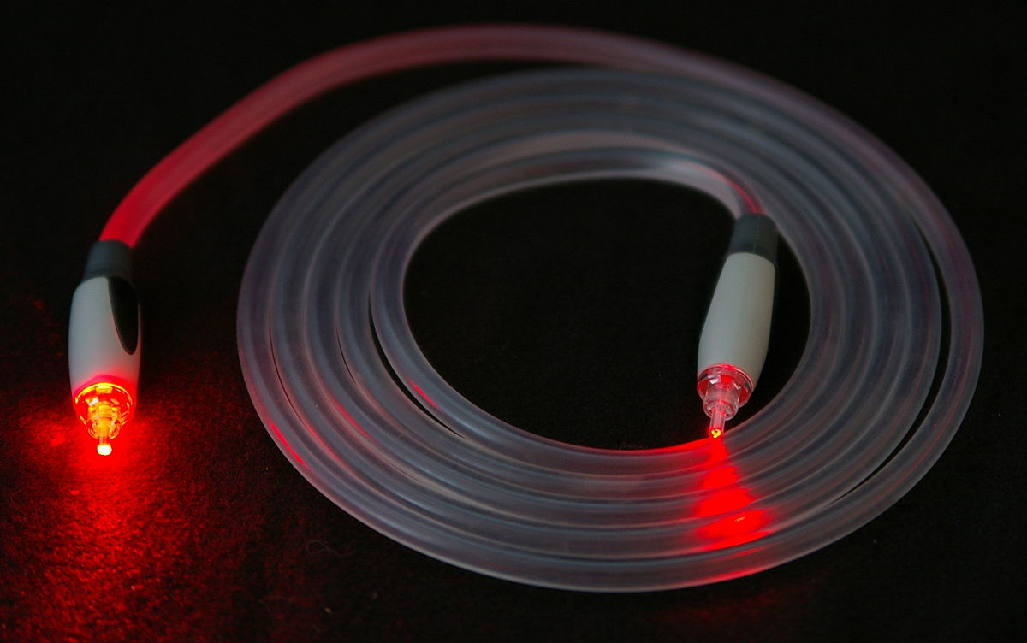
Fiber Optics
by Ali Safarpoor Dehkordi
Advisor:
Dr.Akbari
march_2019 Iran_University_of_science_and_technology

Slide 2
1.What is “Fiber Optic” 2. Construction 3. Physical rules 4. Fiber types 5. Advantages & Problems 6.Applications 7.History 8.Find out more 9.Conclusion 10.References

Slide 3
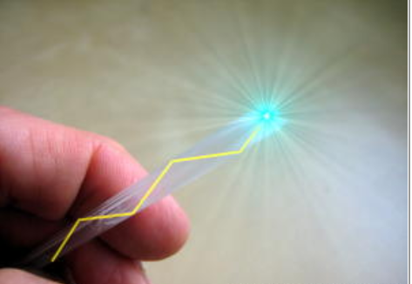
1.What is “Fiber Optics”
fiber optics means sending light beams down thin strands of plastic or glass by making them bounce repeatedly off the walls.
“fiber optics” = “fibre optics”

Slide 4
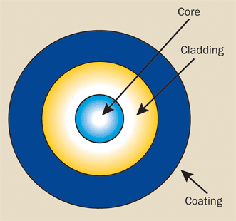
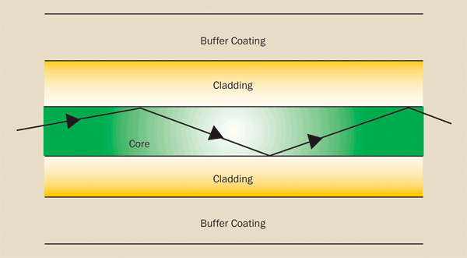
2.Construction
Core
glass , plastic or other materials
light-transmitting portion of the fiber
Cladding
same material as the core
lower index of refraction
total internal reflection
Coating
plastic materials
metallic sheaths
physical protection

Slide 5
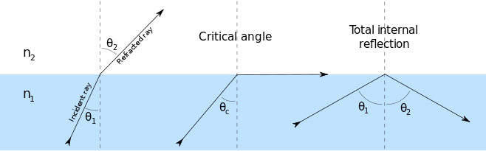
3. Physical rules
Internal reflection
index of reflection
ratio of speed
n_{I}sinI=n_{R}sinR
critical angle
typically about 82° for optical fibers

Slide 6
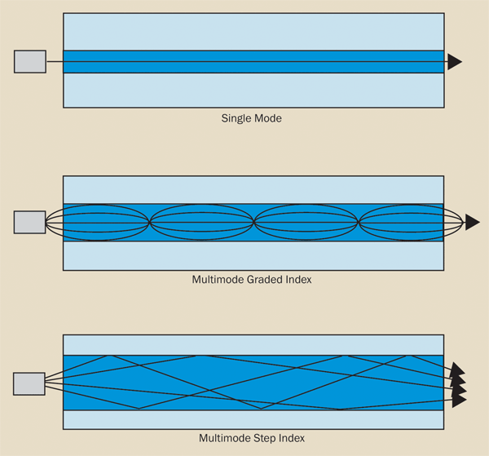
4. Fiber types
single mode
no reflection
higher bandwidth
less overlap
modern long-range communication systems
core diameters are between 5 and 10 µm
multimode graded index
core diameters are between 50 and 100 µm
index of refraction decreases continuously
medium-range communications
local area networks.
multimode step index
core diameters of 100 to 1500 µm
short data transmission distances
high power densities
medical and industrial laser power delivery

Slide 7
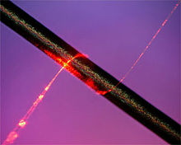
5.1..Advantages
Less attenuation: “میرایی کمتر”
Information travels roughly 10 times further before it needs amplifying—which makes fiber networks simpler and cheaper to operate and maintain.
No interference:
Unlike with copper cables, there's no "crosstalk" (electromagnetic interference) between optical fibers, so they transmit information more reliably with better signal quality
Higher bandwidth:
fiber-optic cables can carry far more data than copper cables of the same diameter.
Inexpensive, Thin and Light

Slide 8
5.1..Problems
Limitations in Local Area Networks
People are comfortable with what they have and don't want to change.
fiber optic LANs
Economic Evaluation
investment costs and operation costs
other components of fiber optics add up, such as transmitters, receivers, couplers and connector

Slide 9
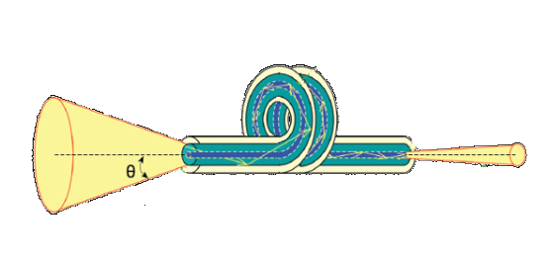
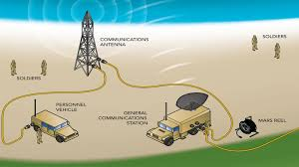
6.1..Applications
Power Delivery:
deliver remarkably high levels of power
laser cutting, welding, marking, and drilling
Communications:
Voice transmission , data ~ , video ~ Telecommunications LAN Industrial control system Military : connections , Radar , robust against electromagnetic interference

Slide 10
6.2..Applications
Sensing: light from a remote source to a detector to obtain pressure, temperature or spectral information The fiber also can be used directly as a transducer to measure a number of environmental effects, such as strain, pressure, electrical resistance, and PH.
Illumination: – A bundle of fibers gathered together with a light source at one end can illuminate areas that are difficult to reach – for example, inside the human body, in conjunction with an endoscope. Also, they can be used as a display sign or simply as decorative illumination.

Slide 11
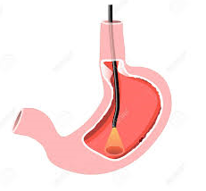
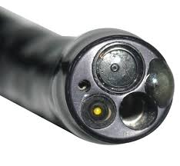
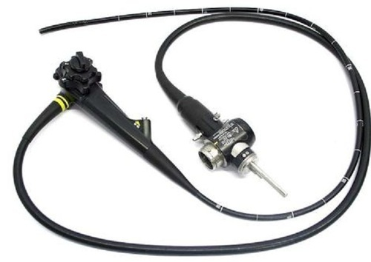
6.3..Applications
Medicine
gastroscope
lab on a fiber

Slide 12
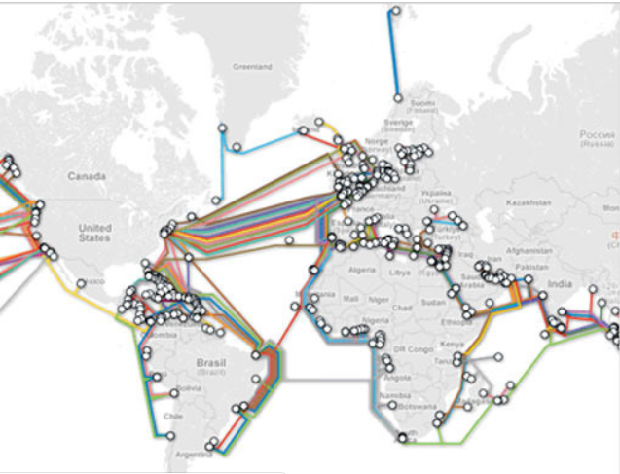
6.4..Applications
Internet
fiber cables cover over 99 percent of the Internet's total mileage, and carry over 99 percent of all international communications traffic99 percent of the Internet's total mileage, and carry over 99 percent of all international communications traffic
Dark fiber

Slide 13
7.History
1840s: discovered it is possible to shine light along a water pipe. The water carried the light by internal reflection.
1950s: a simple picture sent down a light pipe made from thousands of glass fibers.
1957: fiber-optic technology used to make the world's first gastroscope.
1960s: first fiber-optic cable capable of carrying telephone signals.
1977: The first fiber-optic telephone cable was laid between Long Beach and Artesia, California.
1988: The first transatlantic fiber-optic telephone cable, TAT8, was laid between the United States, France, and the UK.
2018: According to TeleGeography, there are currently around 450 fiber-optic submarine cables (carrying communications under the world's oceans), stretching a total of 1.2 million km (0.7 million miles).

Slide 14
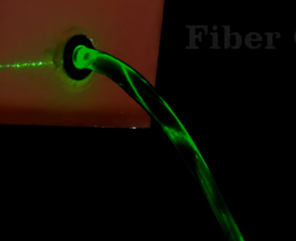
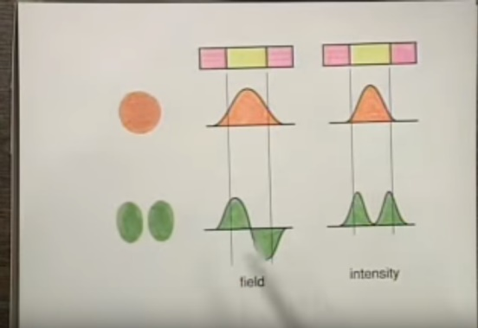
8.Find out more!
Books
Understanding Fiber Optics by Jeff Hecht
Optical Network Design and Implementation
by Vivek Alwayn
City of Light The Story of Fiber Optics by Jeff Hecht
Try this fiber-optic experiment! The nice little experiment by Irish physicist John Tyndall in 1870
Video:(just click on pictures)

Slide 15
9.Conclusion
vast array of applications
essential points about fiber optics :
higher bandwidth higher interconnection densities lower crosstalk higher speed

Slide 16
10.References
Woodford, Chris. (2006/2018) Fiber optics. Retrieved from https://www.explainthatstuff.com/fiberoptics.html
https://www.thoughtco.com/birth-of-fiber-optics-4091837
https://www.photonics.com/Articles/Fiber_Optics_Understanding_the_Basics/a25151
https://www.youtube.com/watch?v=0MwMkBET_5I
https://www.youtube.com/watch?v=jy9VSNXkbx4
http://www.doc.ic.ac.uk/~nd/surprise_97/journal/vol4/sm27/projects.html

Slide 17
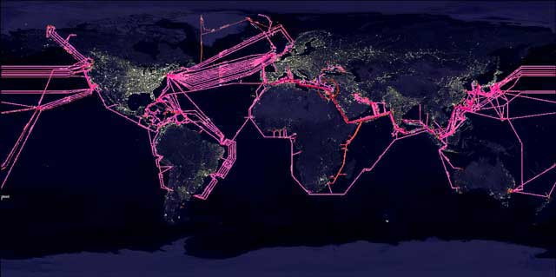
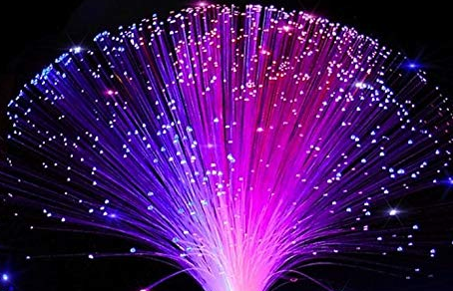
Thanks for your attention

